Slide 1

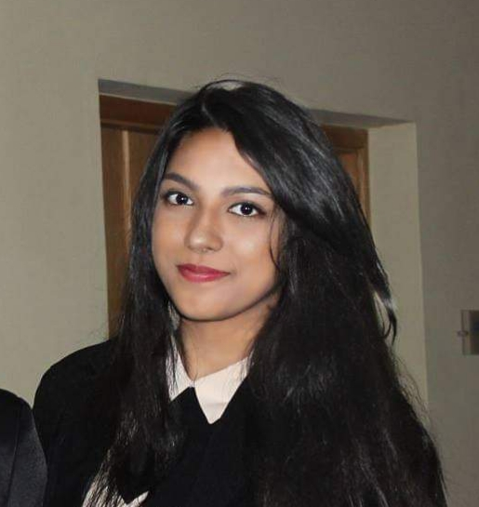

Work experience
Areas of expertise
.
Accenture Mauritius (May 2021 – Present)​
Client – Thales / Project – Performance Cockpit
Power BI developer (July 2021 – January 2022)
Created customized charts, customed calculations and calculated measures as per requirements
Worked in a team using Agile/Scrum methodology
Transformed data using Power Query​
Worked with the UI/UX designer to design and create dashboards and interactive visual reports using Power BI
Used proper data visualization tools to help the user make informative decisions
Configured RLS for data models imported into Power BI
Tabular modelling using SQL Server Analysis Services (SSAS)
Data transformation and migration using SQL Server Integration Services (SSIS)
Past experiences
GDS Groupe (August 2020 – April 2021)​
Development on the company’s website, design new website and mobile pages, administer the company’s database, test, debug and improve.
Infomil Mauritius (February 2020 – June 2020)​
Create a full-fledged leave management system for the company
Technical
Power BI – DAX Modelling, Power Query, Dashboard, Aggregate functions, Reports, Q&A, Logical and Filter Functions, RLS, SSMS, SSAS, SSIS
Basics of Power Apps, Power Automate and Power Virtual Agents
HTML, CSS, JavaScript/ExtJs, PHP & Laravel and Basics of C#/.Net
SQL – MySQL, Oracle
Functional
Agile Methodology
Industries
IT Consulting
Manufacturing
Road traffic management
Farhiinah Toofany
Associate Software Engineer
Education
Professional background
Bachelor Degree in Business Information Technology and Systems
Degree holder in Business Information Technology and Systems from Curtin University with around 2 years of experience as a developer.
Certifications
PL-900 – Microsoft Power Platform Fundamentals
AZ-900 – Microsoft Azure Fundamentals
DP-900 – Microsoft Azure Data Fundamentals

Slide 2


Accenture Mauritius
(May 2021 – Present)
Work in teams on projects assigned to us by the company and meet client expectations.
Power BI Developer
Skills & technology applied
Analytical reasoning.
SQL Server Management Studio (SSMS)
Data modelling, Data transformation and ETL
Designing of dashboards and interactive visual reports using Power BI
Use of proper data visualization tools to help the user make informative decisions
Creation of customized charts, customed calculations and calculated measures as per requirements
Use of Analytical Languages to manipulate data (DAX and Power Query)
Configure RLS for data models imported into Power BI
Tabular modelling using SQL Server Analysis Services (SSAS)
Data transformation and migration using SQL Server Integration Services (SSIS)
Description
Worked in a team using agile methodology to develop apps through Microsoft Power Platforms, where I was specialized in Power BI and its analytical languages such as Data Analysis Expressions (DAX) and Power Query.
• Technologies used: Microsoft Power Platforms, SQL server Management Studio (SSMS), SQL Server Analysis Services (SSAS), SQL Server Integration Services (SSIS), Azure DevOps, Jira, Git.

Slide 3

GDS Groupe
(August 2020 – April 2021)
Development on the company’s website, design new website and mobile pages, administer the company’s database, test, debug and improve.
IT Developer
Skills & technology applied
Knowledge of Object-Oriented programming technologies
Analytical reasoning.
Database administration using SQL.
Back-end development using PHP/Laravel.
Front-end development using JavaScript/ExtJs, Html and CSS.
Problem solving skills applied in testing and debugging,
French writing skills to write application documentations.
In-depth testing and detailed report writing.
Description
Work on the company’s web and mobile applications. My main tasks were to constantly add new functionalities, design the mobile application, test, debug and document the applications.
The technologies I worked with: HTML, CSS, PHP/ Laravel, JavaScript/ExtJS, Java, PostgreSQL, Cordova, Sqlite, QGIS, BitBucket,

Slide 4

Infomil Mauritius
(February 2020 – June 2020)
Create a full-fledged leave management system for the company
IT Internship
Skills & technology applied
Knowledge of the MVC model.
Teamwork.
Scrum board management and sprint backlog monitoring.
Documentation writing.
Front-end development using HTML, CSS and JavaScript.
Testing, debugging and report writing.
Description
Create a full-fledged leave management system for the company, in a team of 4 people, using ASP.NET, HTML, CSS, JavaScript, Bootstrap, C#, XML and JSON,.
Parallel to working on the project, I was elected as the Scrum Master of the team and had to monitor Sprint backlogs and manage the Scrum board

